Slide 1
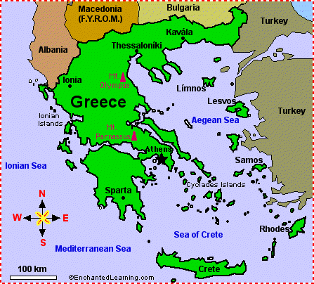
Greece is located in southern Europe.

Slide 2
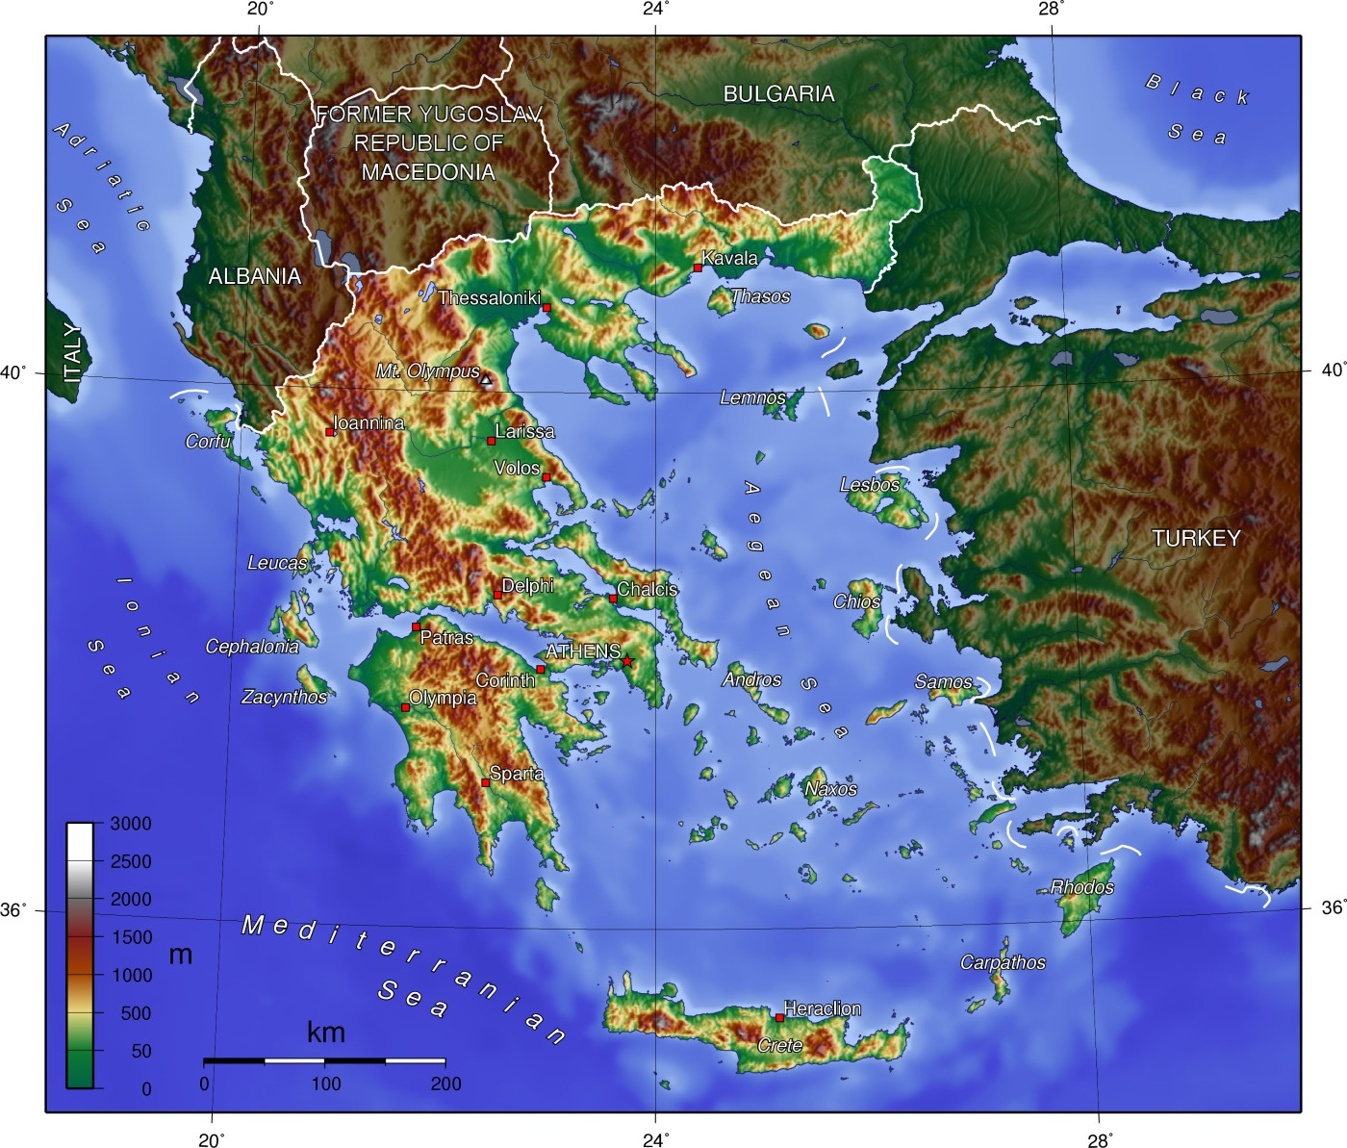
Greece has the largest coastline in Europe and is know for the thousands of islands right off the coast.

Slide 3
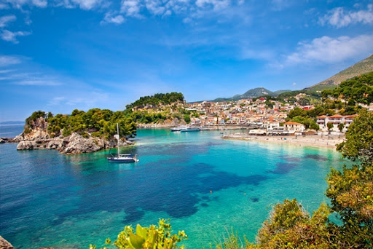
The mainland of Greece is known for its rugged mountains, forests, and lakes.

Slide 4
THE STONE AGE
There has been signs of life in Greece dating back to the palaeolithic era between 11,000-3,000 BC
Civilization became more advanced during 3,500 and 3,000 BC.
They became more advanced on their agriculture such as fishing, producing clay, and sea expoditions.

Slide 5
The Classical period
From the 6th to the 4th century, Athens was the dominating power in the Aegean Sea and had developed strong connections with ports around the Mediterranean Sea.
Until the beginning of the 6th century, Athens was ruled by aristocrats and generals.
The rivalry between Athens and Sparta led to the Peloponnesian War (431-404 BC), a war that gradually included almost all towns of Greece as allies of either Athens or Sparta.

Slide 6
The Roman period
Greece under the Roman Empire, from 31 BC to 180 AD is described as the era of the Pax Romana, a Roman Peace between Rome and the central areas of the Empire, like Greece and the Greek East.
This period is described as a period of peace and security which permitted economical and cultural progress, especially in the cities such as Athens, Corinth, Alexandria, Miletus, Thessaloniki, and Smyrna.
Due to a decentralized Roman provincial administration, the urban Greek elite re-appeared, which also had the right to participate in the Roman Senate.

Slide 7
Ottomans period
On March 25th, 1821, after four centuries of Ottoman occupation, the Greek Revolution broke out.
Sporadic revolts against the Turkish broke out in the Peloponnese and the Aegean islands by some determined guerrilla fighters.
A year later, the rebels had set the Peloponnese free and the independence of Greece was declared in January 1822 by the National Assembly of the Greeks.

Slide 8
20th Century
The early 20th century finds Greece weak after many bankruptcies and the lost Greco-Turkish war of 1897.
In 1912, after the first Balkan Wars, Macedoniaand Epirus are attached to the Greek State and in 1913, it was the turn of Crete to be united to the rest of Greece.
These were the results of the political efforts of Eleftherios Venizelos, an inspired Cretan leader that became prime minister of Greece. Venizelos worked hard for the reunification of all Greece, he established constitutional amendments and social laws and re-equipped the army. He managed to stabilize the country to a great extent.

Slide 9
Greek food and wine is an important aspect of the culture of Greece. Greek food and wines are famous for their good quality and amazing taste. Some dishes are common all around the country, whereas some others are local culinary specialties and can be found only in a specific region or Greek island. Here are some of the popular dishes.
Tzatziki
Saganaki
Keftedakia
Spanakopitakia

Slide 10
The religion of Greek people is an important aspect of Greek culture.
The population in mainland Greece and the Greek islands is Christian Orthodox per 90%. The religion of the rest of the population is Muslims, Catholic, Jewish and other minorities.
Greece and Russia are the only countries to have such a great proportion of the Orthodox population.

Slide 11
The First written language
The first written Greek letters were found on baked mud tablets, in the remains of the Minoan Knossos Palace of Crete island.
This language is known as Linear A and it has not been fully decoded till today. The most famous example of Linear A is written in the famous Phaistos Disc.
In the 12th century BC, a new language started to develop, called Linear B, where each drawing symbol is a consonant-vowel combination.

Slide 12
Music
Music in Greece is of unbelievable diversity due to the creative Greek assimilation of different influences of the Eastern and Western cultures of Asia and Europe.
It has a long history dating from the Antiquity, during which poetry, dancing, and music were inseparable and played an important part in the ancient Greek's everyday life.
https://www.youtube.com/watch?v=i-mGlkqPvwI

Slide 13
Folk Songs (Dimotiko Tragoudi)
The klephtic style was born between the end of the Byzantine period and the beginning of the Greek Revolution that led to the Greek Independence in 1821.
This style was created by the "kleftes", the heroes who left to live in the mountains, leading a revolutionary action against the Ottoman tyranny.
Musical instruments used in Greek folk songs are the lira and laouto (lute), the tambouras and gaida (bagpipe), the zournas (shawm), the daouli (drum), the dachares (tambourine), the ziyia (paired groups) and the violi (violin).

Slide 14
Kantada
Originated from Kefalonia island and created at the beginning of the 19th century, it is a style of romantic serenade music, sung with three male voices in chorus, accompanied by guitar or mandolin.
This style had been influenced by Italian music and soon gained all the Ionian Islands and the rest of Greece.
https://www.youtube.com/watch?v=Zf87GGVtiIM

Slide 15
Rebetiko
This particular and famous style of music in Greece was born in the hashish dens and the tekedes, the Turkish style underground cafes of the district of Piraeus and the city of Thessaloniki.
Rembetiko music was spread by the two million Greek refugees coming from Asia Minor in 1922, after the destruction of Smyrna by the Turks.
The rebetiko slowly in the 1950s came out of the underground world and started to be played in the nightclubs of Athens, where it became very popular, even if it was despised by the Greek people because they saw it as outcast music.

Slide 16
20th-century music
In the 1980s, modern artists like Dionyssis Savopoulos, Georgios Ntalaras, Nikos Papazoglou, Stavros Xarhakos, and Pavlos Sidiropoulos rehabilitated the rembetiko music and mixed it with rock music, bringing to life a new, passionate and interesting kind of music.
Their lyrics were about personal or political freedom (Savopoulos, Ntallaras, and Sidiropoulos), or about aspects of everyday life, pain and sorrow (Papazoglou), and drugged generation (Sidiropoulos).
https://www.youtube.com/watch?v=EbleLNST96k

Slide 17
Dance
Sani festival that is a yearly celebration since 1993.
This event brings together nationally and internationally acclaimed artists at Sani Halkidiki.
https://www.youtube.com/watch?v=mU-JB4wYetY

Slide 18
Sani Festival
The program dedicated to classical music, which for a number of years provided a showcase for talented young Greek musicians.
In 2013, the Sani Classic section was reimagined as Classic Waves encompassing worldwide major orchestras, small ensembles and individual artists.
This festival also host dance performances along with musical performances.

Slide 19
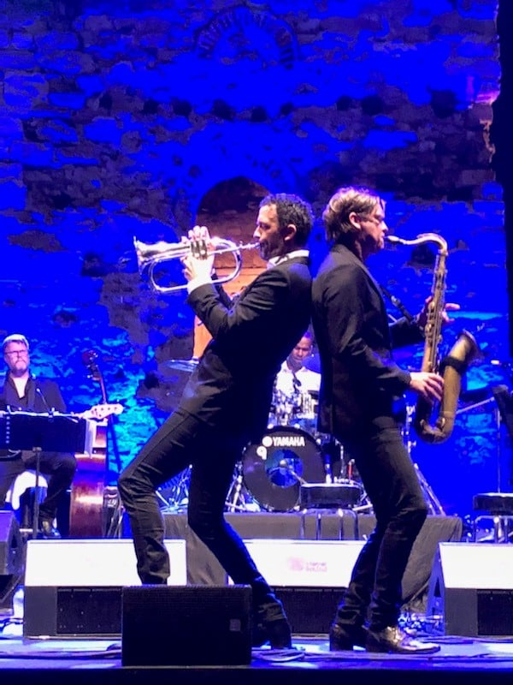
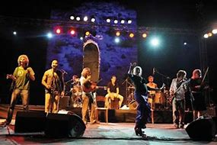
Sani festival

Slide 20
Theatre
Theatre in Greece was a form of entertainment in the ancient times.
In todays time theatre is not as popular as it was in ancient Greece.

Slide 21
Ancient Greek Theatre
The Greek theatre history began with festivals honoring their gods.
At the early Greek festivals, the actors, directors, and dramatists were all the same person.
After some time, only three actors were allowed to perform in each play. Later few non-speaking roles were allowed to perform on-stage.

Slide 22
Ancient Greek Theatre
Comedy was also an important part of ancient Greek theatre.
The cast of a Greek play in the Dionysia was comprised of amateurs, not professionals (all male).
Ancient Greek actors had to gesture grandly so that the entire audience could see and hear the story.
https://www.youtube.com/watch?v=2CVO9Vd067U

Slide 23
Travel site
Greece is famous and notable for being the birthplace for many things.
Democracy, Philosophy, and the Olympic Games all were birth in Greece.

Slide 24
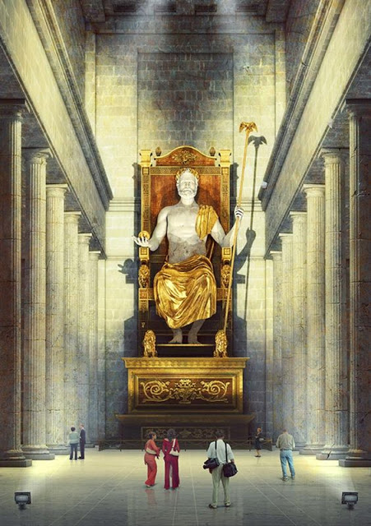
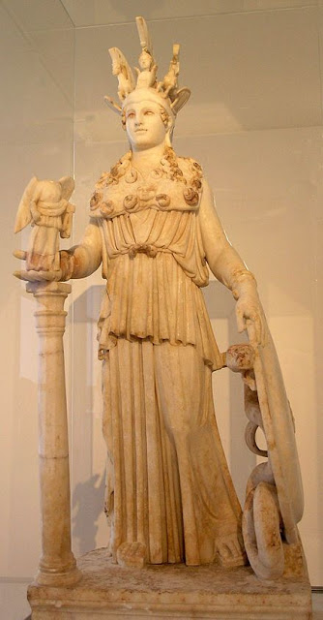
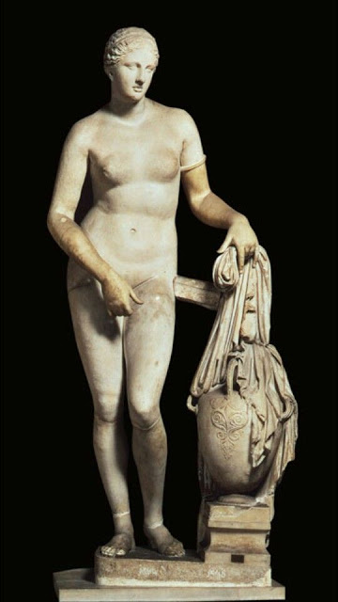
Travel site
Greece is also famous for its statues of Greek Gods.
Statues of Zeus, Athena Parthenos, Aphrodite are all popular tourist attractions.

Slide 25
References
https://greekerthanthegreeks.com/2017/09/25-of-most-famous-ancient-greek-statues.html
https://www.greeka.com/greece-culture/
http://www.ancientgreece.com/s/Theatre/

